Slide 1
Pedaling Forward: The Evolution of Bicycling Infrastructure in 3 Canadian Cities from 2010 to 2022
Richard Wen Brice Batomen Linda Rothman
Postdoctoral Fellow Assistant Professor Associate Professor
Dalla Lana School of Public Health Dalla Lana School of Public Health School of Occupational and Public Health
University of Toronto University of Toronto Toronto Metropolitan University
richard.wen@utoronto.ca brice.kuimi@utoronto.ca linda.rothman@torontomu.ca
CARSP Conference 2024 | Ottawa, Ontario | June 16-19, 2024 |Session1 B: Cyclist Safety

Slide 2

Cycling … Healthy, but Risky?¹
Cleaner Air
Pollution Exposure
Reduced Traffic & Noise
Higher Risk of Injury & Death
e.g. 2.3X injury, 1.8X death versus
vehicles in US (1999-2003)
Improved Fitness & Mental Health
Longer Lives
Shorter Lives
¹Teschke, K., Reynolds, C. C., Ries, F. J., Gouge, B., & Winters, M. (2012). Bicycling: Health risk or benefit. UBC Med J, 3(2), 6-11.

Slide 3
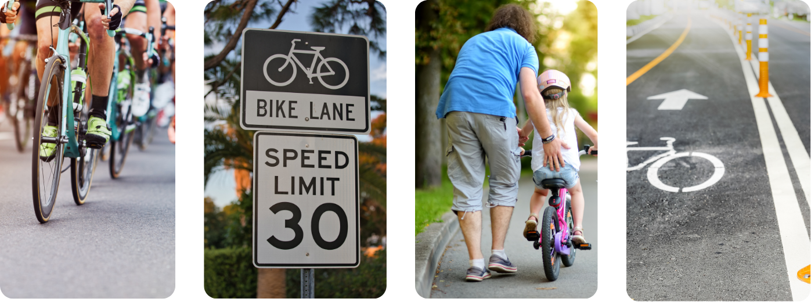
The Pandemic Cycling Boom and Safer Streets
More Cyclists
11 of 13 Countries²
(e.g. +27% Italy²)
Reduced Speed Limits
30 km/h
(e.g. Slow streets Vancouver³)
Cycling Education
Free Courses
(e.g. 6/7th grade schools Vancouver⁴)
More Infrastructure
Network Expansions
(e.g. 17 routes by 2027 Montréal⁵)
²Buehler, R., & Pucher, J. (2022). Cycling through the COVID-19 pandemic to a more sustainable transport future: Evidence from case studies of 14 large bicycle-friendly cities in Europe and North America. Sustainability, 14(12), 7293.
³https://vancouver.ca/streets-transportation/making-streets-for-people-program. ⁴https://bikehub.ca/bike-to-school
⁵https://montreal.ca/en/articles/ebn-montreals-express-bike-network-4666

Slide 4
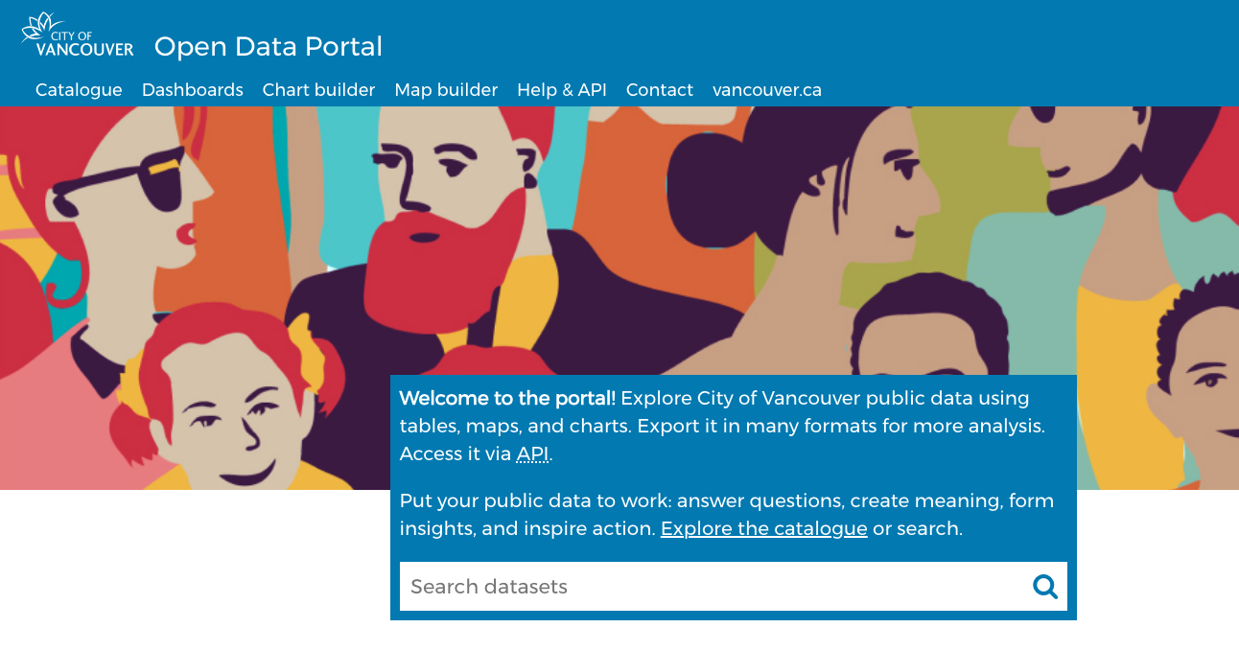


Infrastructure: Is it Happening? How Do We Know?
Accuracy?
Consistency?
⁶
Updates?
⁷
⁸
⁶https://opendata.vancouver.ca ⁷https://data.calgary.ca ⁸https://open.toronto.ca

Slide 5

Research Objectives
For dedicated cycling infrastructure (painted lanes, buffered lanes, and cycle tracks as defined by the Canadian Bikeway Comfort and Safety (Can-BICS)⁹ classification system) in the cities of Vancouver, Calgary, and Toronto from 2010 to 2022:
(1) Verify that city installation and upgrade data are accurate
(2) Evaluate yearly trends in cycling infrastructure across cities
⁹Winters, M., Zanotto, M., & Butler, G. (2020). At-a-glance-The Canadian Bikeway Comfort and Safety (Can-BICS) Classification System: a common naming convention for cycling infrastructure. Health promotion and chronic disease prevention in Canada: research, policy and practice, 40(9), 288.

Slide 6
Data
Vancouver Bikeways
opendata.vancouver.ca
3666 Road Segments
Local Street bikeways, protected bike lanes, painted lanes, shared lanes
Included: On-street painted lanes, protected bike lanes, local street bikeways
Calgary Bikeways
data.calgary.ca
4169 Road Segments
Cycle tracks, bike lanes, on-street bikeways, shared lanes, temporary and decommissioned routes
Included: Active bike lanes, cycle tracks
Toronto Bikeways
open.toronto.ca
1323 Road Segments
Cycle tracks, bike lanes, neighborhood routes with sharrows, multi-use trails, signed cycling routes
Included: Cycle tracks, bike lanes

Slide 7



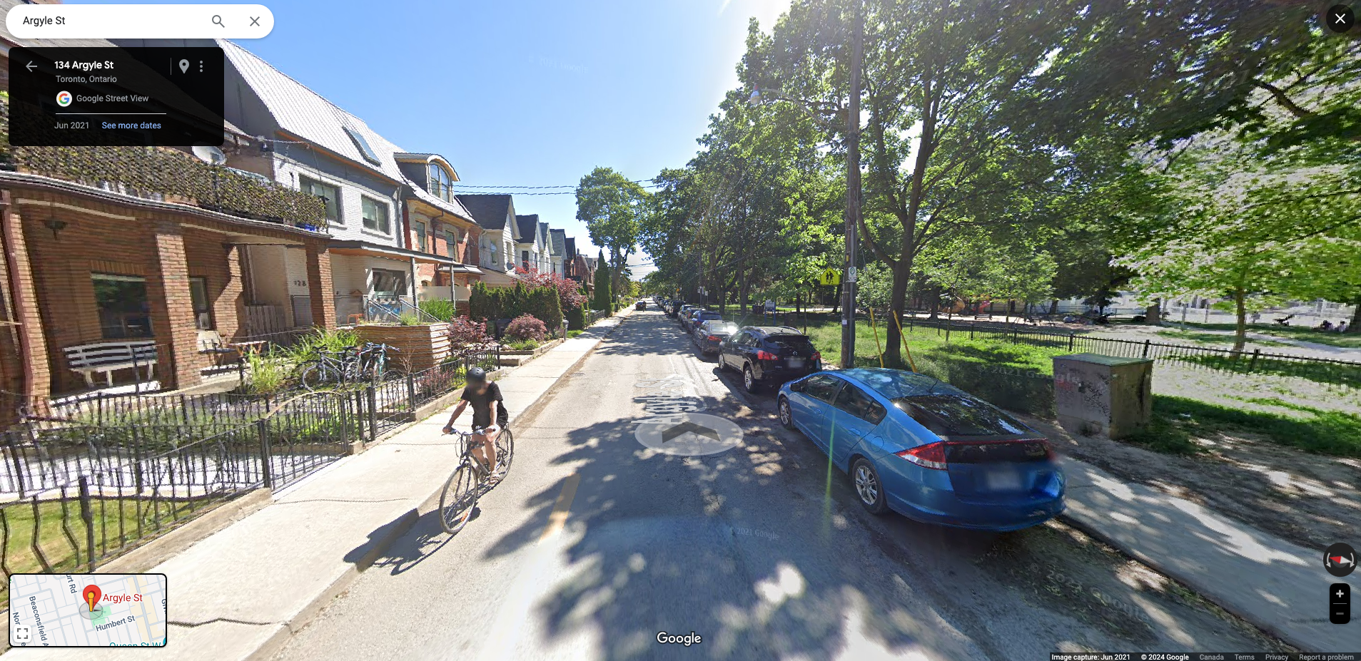
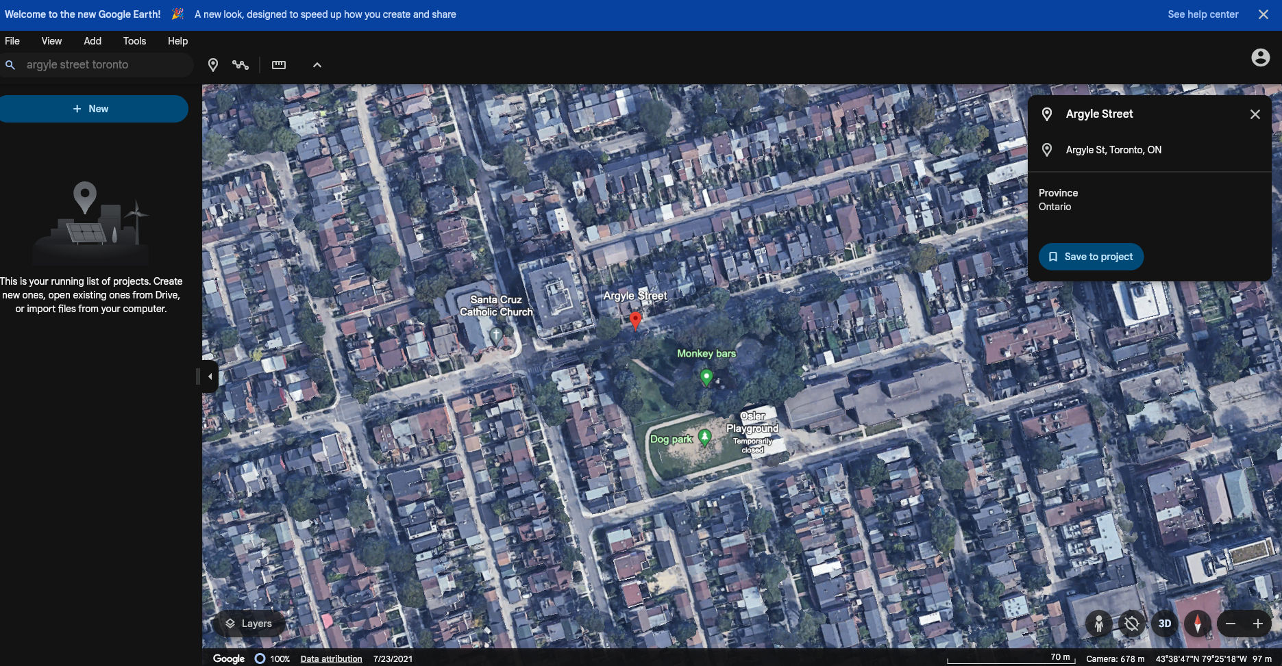

Methods: Verification

Slide 8



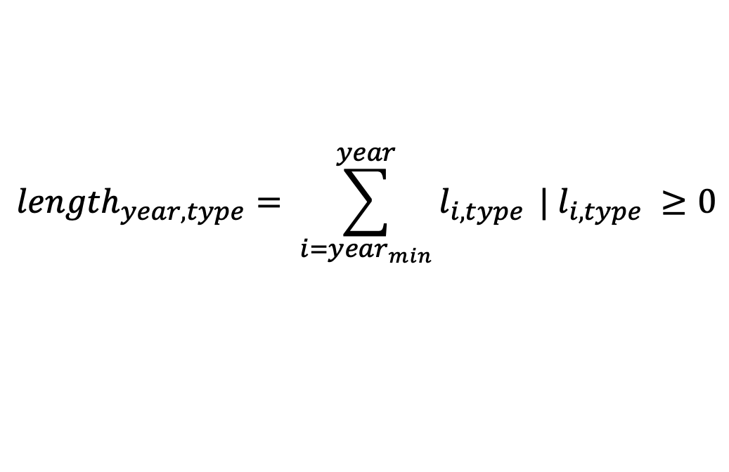
Methods: Evaluation
Yearly Road Lengths
$${length}_{year, type}= \sum_{i={year}_{min}}^{year}{l_{i,type}} | l_{i,type} ≥0$$
Adjusted Yearly Road Lengths
$${length}_{year,type}^{install}+ {length}_{year,type}^{change}− {length}_{year,type}^{replacement}$$

Slide 9
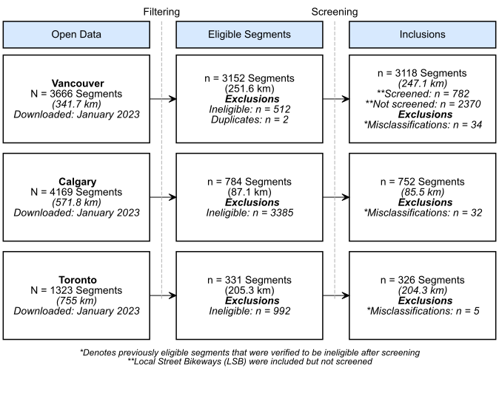
Results: Segment Inclusions and Exclusions

Slide 10
Results: Installation Year Accuracy, Vancouver
83.3% Correct
97.2% ±1 Year
0 = Correct

Slide 11
Results: Installation Year Accuracy, Calgary
42.1% Correct
62.7% ±1 Year
0 = Correct

Slide 12
Results: Installation Year Accuracy, Toronto
74.5% Correct
78.2% ±1 Year
0 = Correct

Slide 13
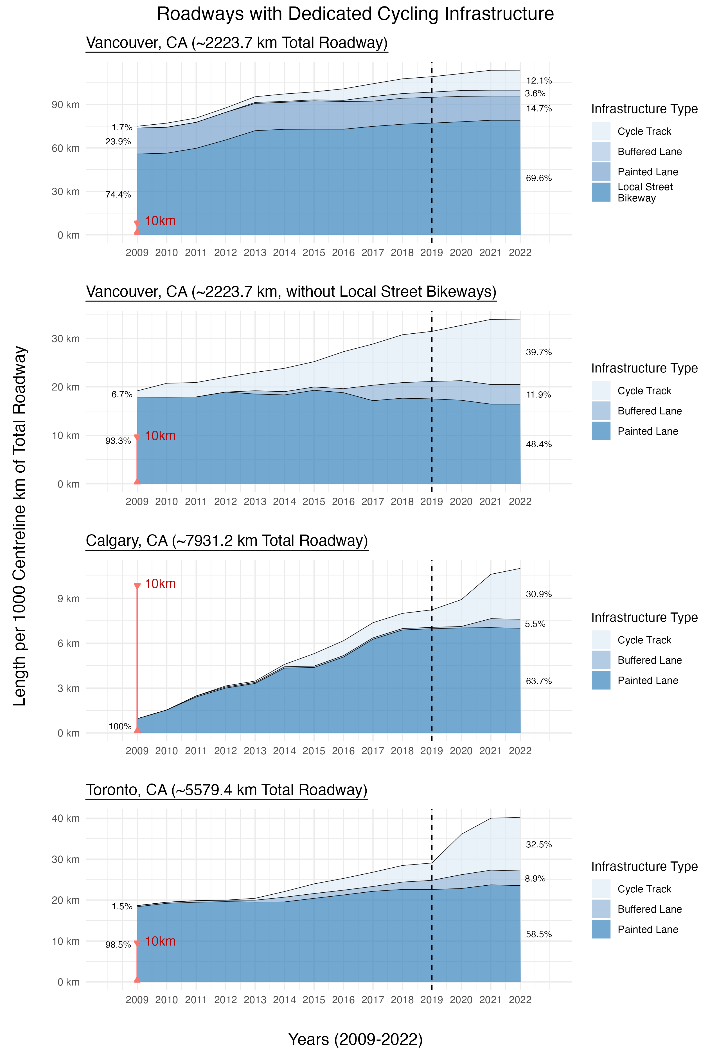
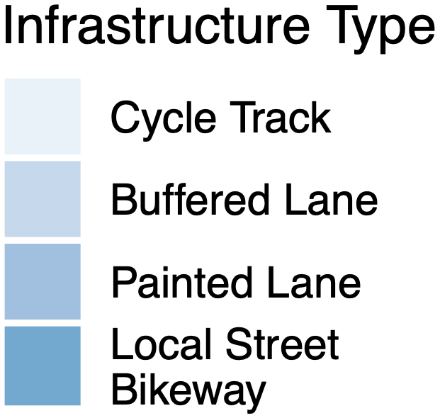
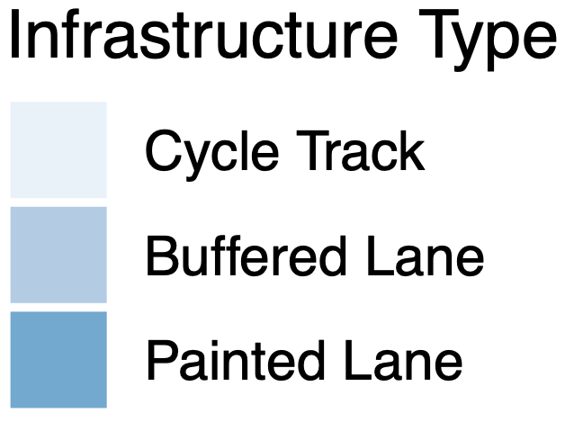
Results: Infrastructure per 1000 km of Roadway

Slide 14
Results: Net Change per 1000 km of Roadway

Slide 15
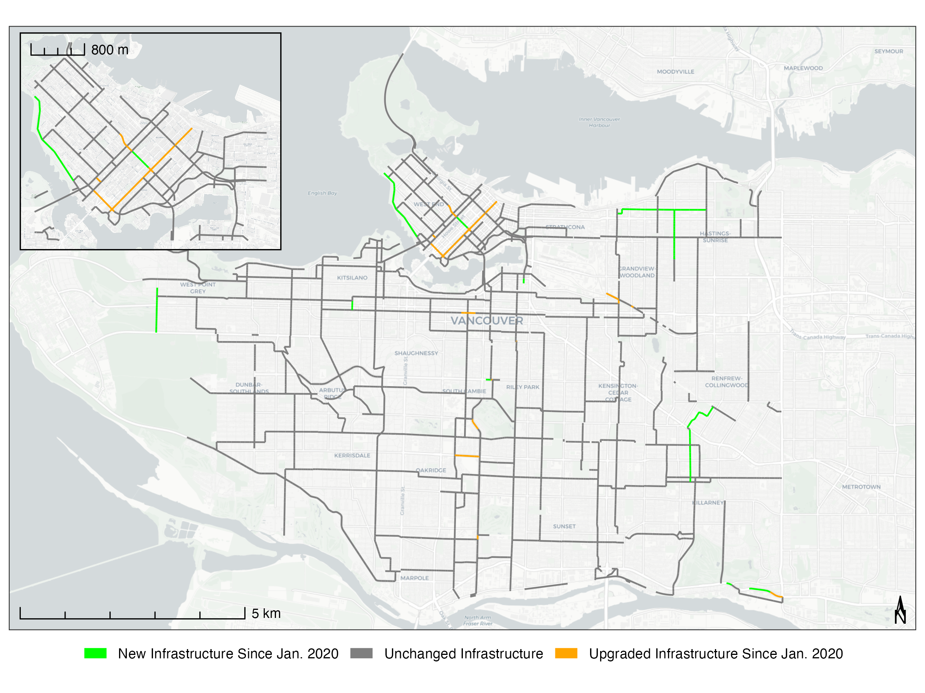
Results: Changes Since January 2020, Vancouver

Slide 16
Results: Changes Since January 2020, Calgary

Slide 17
Results: Changes Since January 2020, Toronto

Slide 18




Discussion
Strengths
Limitations
Comparability
Standardized infrastructure types across cities
Verified Change Data
Cycling data with confirmed changes and evidence
Strict Exclusions
Temporary/mixed infrastructure & directionality not considered
Potential Data Gaps
Possibly incomplete data for 2022 as cities may not update by end of year

Slide 19


Conclusion
Cycling infrastructure growth since 2009 especially after 2019.
Evidence of infrastructure change to guide policy, urban planning & decisions.
~42/74/83% of Calgary/Toronto/Vancouver city data had correct install years.
Need to improve data verification & standards for research purposes.
Trends comparable across cities with standardized infrastructure types. However, care needed to standardize infrastructure types for study purposes.

Slide 20

Acknowledgements
This study was supported by the Canadian Institutes of Health Research (CIHR) as part of the Road-safety Evaluation during COVID-19 among Vulnerable Road Users in Canada (RECOVR) initiative.

Slide 21


Thank You for Your Time! Richard Wen Postdoctoral Fellow richard.wen@utoronto.ca R Code and Data for Figures and Tables
https://rrwen.github.io/recovr-infracycle

